Slide 1
BHP 2017 Projected Net Revenue Requirement
Meeting
October 25, 2016

Slide 2
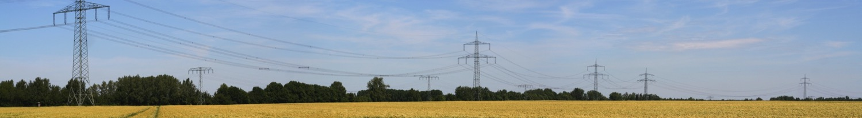
Agenda
Introductions
CUS Transmission System Overview
Black Hills Power’s Formula Rate Protocols
Discuss the 2017 Projected Net Revenue Requirement
Where to Find Information and be Engaged
Questions & Comments

Slide 3
CUS Transmission System
The Common Use System (CUS) is a joint transmission system owned by Basin Electric Power Cooperative, Black Hills Power, Inc. and Powder River Energy Corporation.
The CUS has filed with the FERC a joint open-access transmission tariff that provides transmission service over these combined assets that consist of 230 kV and limited 69 kV transmission facilities within areas of Southwestern South Dakota and Northeastern Wyoming.
The CUS is made up of approximately 980 circuit miles

Slide 4
Common Use System
MONTANA
WYOMING
TONGUE
RIVER
SHERIDAN
BILL DURFEE
LOOKOUT
CARR
DRAW
DRYFORK
WYODAK
(2016)
YELLOWCREEK
BUFFALO
HUGHES
LANGE
WYGEN1
WYGEN2
WYGEN3
DONKEY
CREEK
(2017)
BARBER
CREEK
OSAGE
RENO
SOUTH RAPID CITY
DC TIE
PUMPKIN
BUTTES
(2016)
TECKLA
MINNEKHATA
WESTHILL
ANTELOPE
YELLOWCAKE
S DAKOTA
LATIGO
WINDSTAR
NEBRASKA
CASPER
230 KV (EXISTING)
230 KV (FUTURE)
SUBSTATION
GENERATOR
CUS PAC
BEPW WAPA
DAVE
JOHNSTON
SPENCE
STEGALL

Slide 5
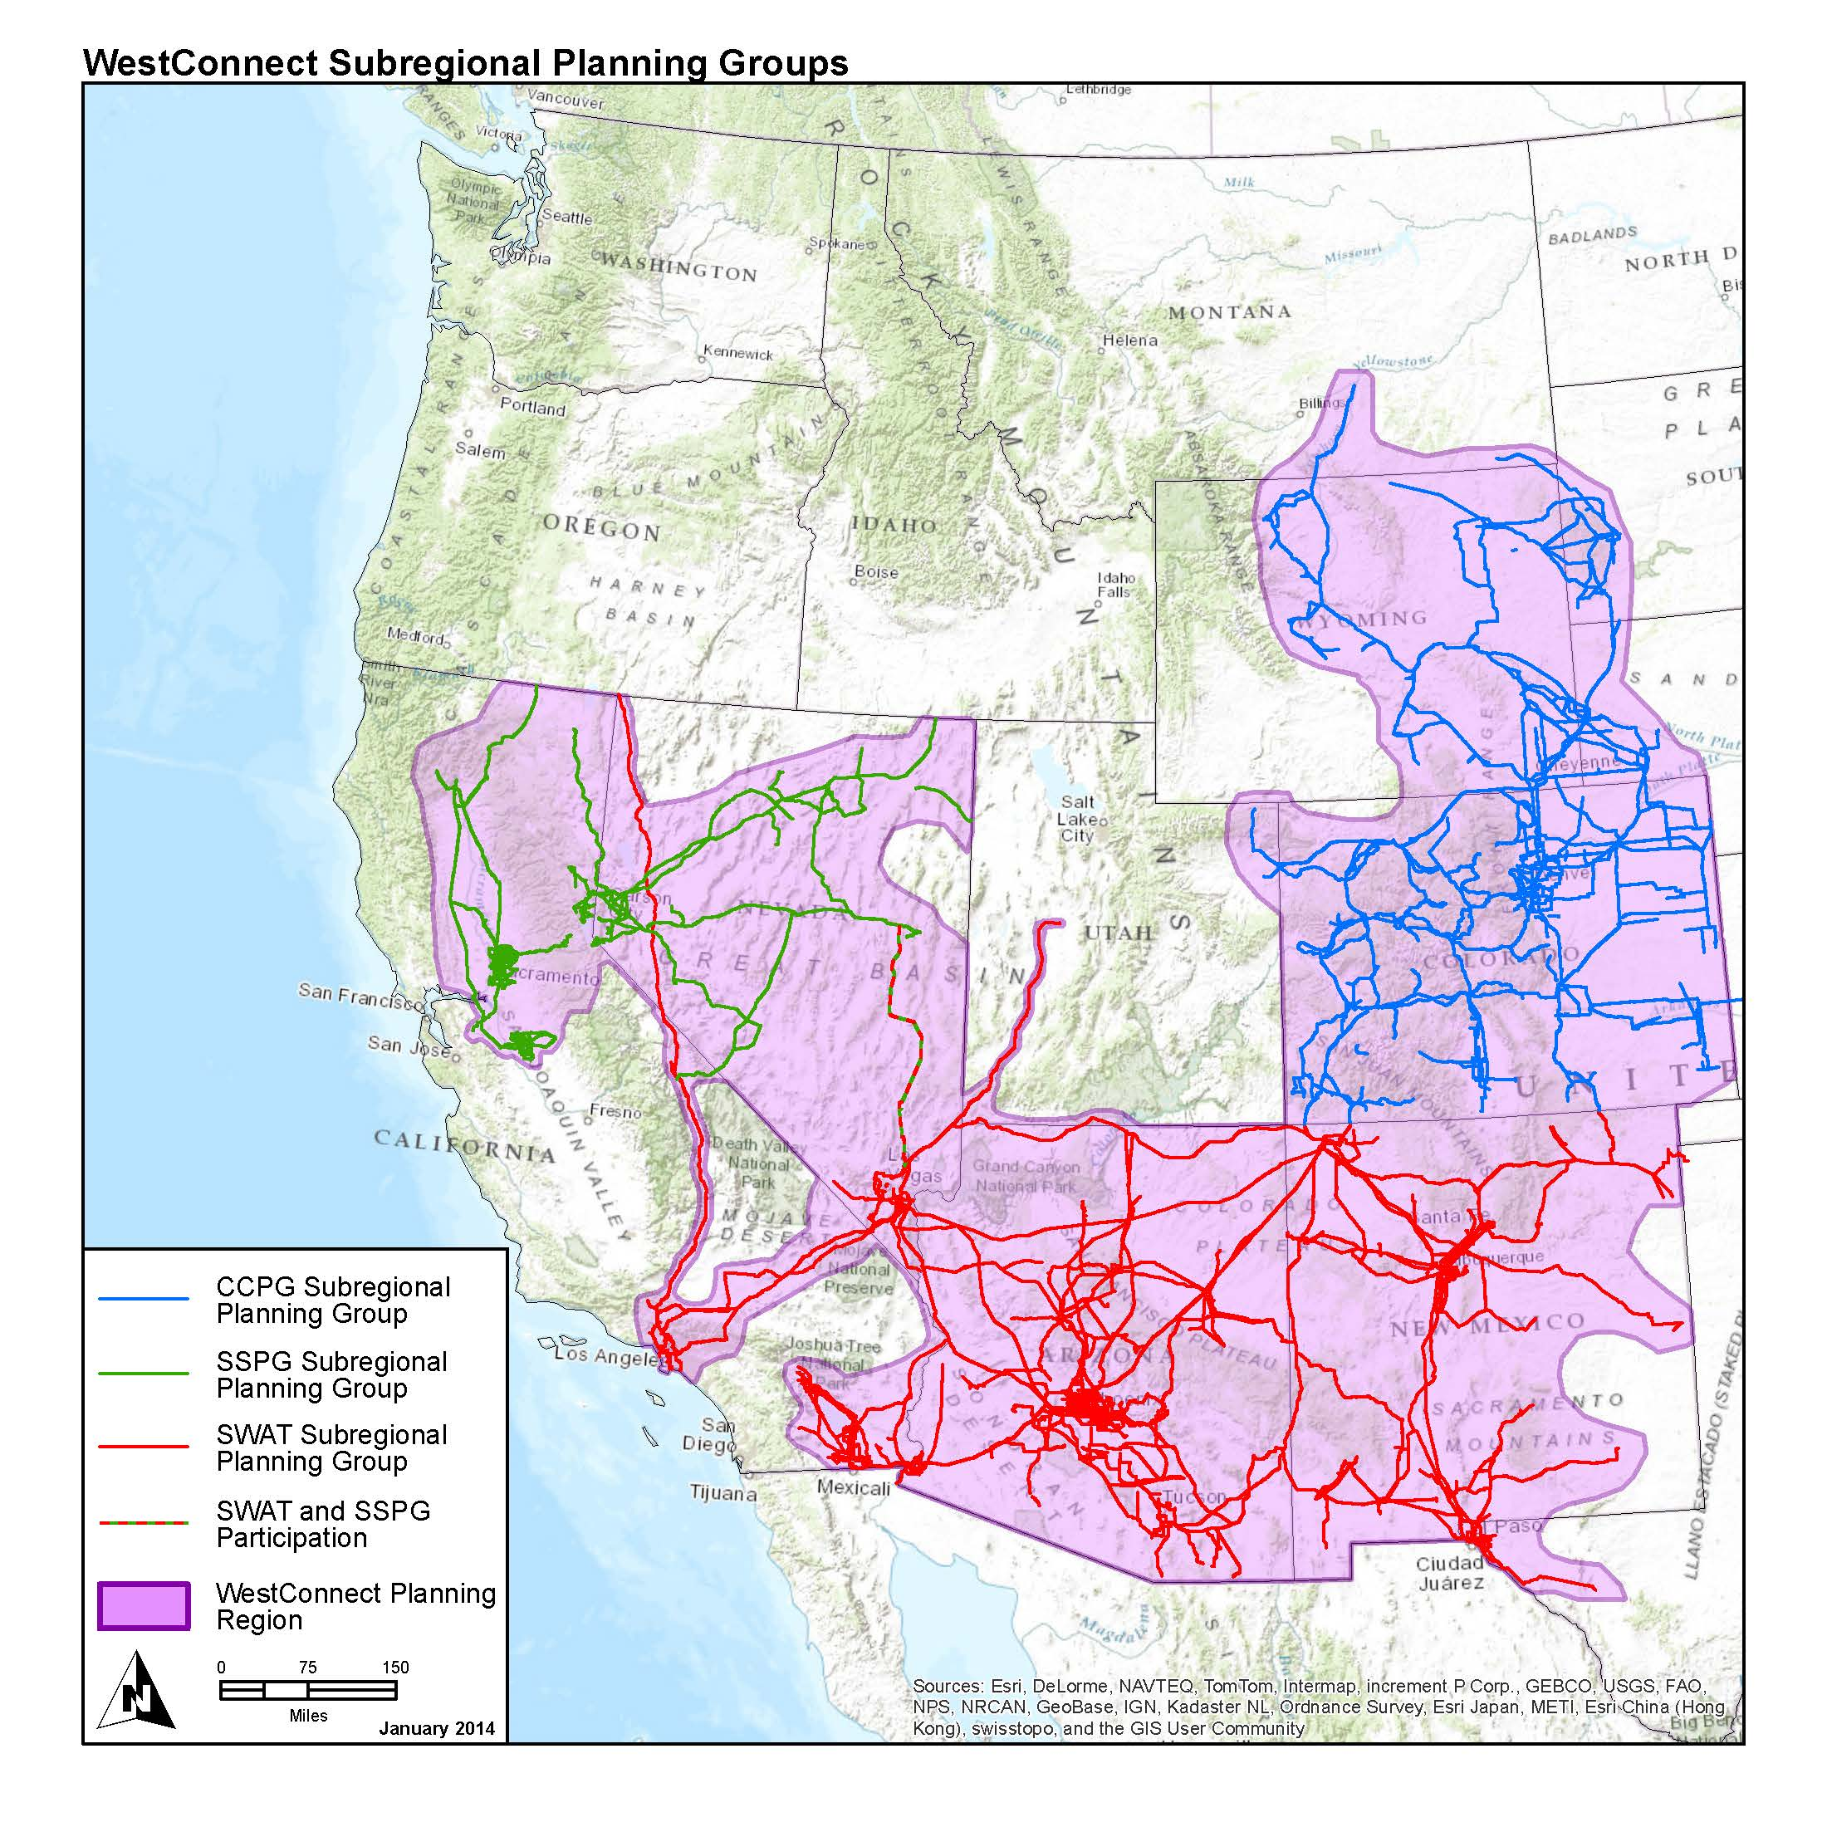
Where We Are in the West
BHBE / Common Use System
CCPG—Colorado Coordinated Planning Group
SSPG—Sierra Subregional Planning Group
SWAT—Southwest Area Transmission

Slide 6
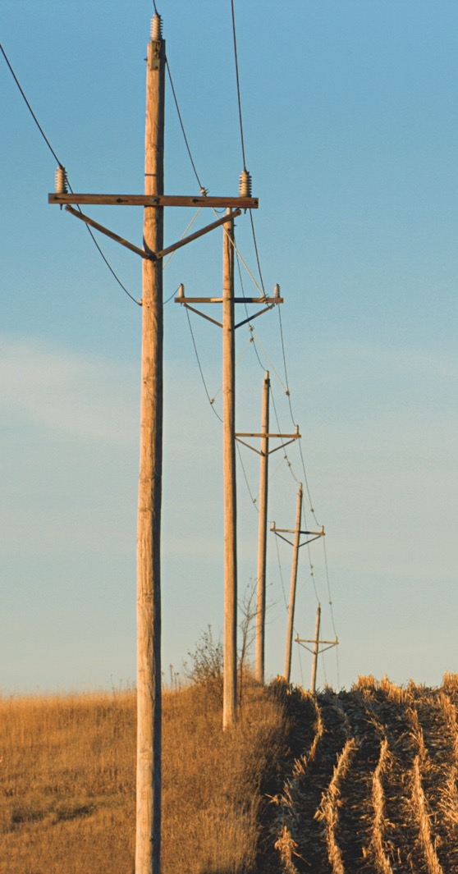
Formula Rate Protocols
In July 2014, the Federal Energy Regulatory Commission (FERC) requested that Black Hills update its formula rate protocols
The updates were needed to:
    Provide clarification on who can participate in the information exchange
    Increase transparency
    Create challenge procedures
  Black Hills Revised its tariff and the new formula rate protocols went into effect January 1, 2015

Slide 7

Summary of Key Drivers
2017 total projected revenue requirement increases $1,999,492 or 12.49% over 2016.
2017 projected annual rate is $35.52 kW-Yr, an increase of $1.94 kW-Yr over 2016.
Primary driver of increase
    Addition of a transmission line from Teckla to Osage with an in service date of August 2016.
    Projected addition of transmission line from Osage to Rapid City in 2017.
    Projected addition of transmission line from Hot Springs to Lonewell Creek in 2017.

Slide 8
2017 Projected Revenue Requirement

Slide 9

How to be Engaged
We invite our transmission customers to sign up to receive notices related to the Projected Net Revenue Requirement and Annual True-Up. A notification will be sent by email whenever there is an update. These notifications are also posted on our OASIS site. https://www.oasis.oati.com/BHBE/index.html
To sign up for the notices go to our website www.blackhillsenergy.com. In the list on the left click on In Your Neighborhood. Next click on Transmission & Distribution then Transmission Rates. Under More Information click on the link Sign up for notices. Key in your email address and click Subscribe.
If you have any questions please contact us on our transmission line at 605-721-2220 or email Transmissionservice@blackhillscorp.com.

Slide 10
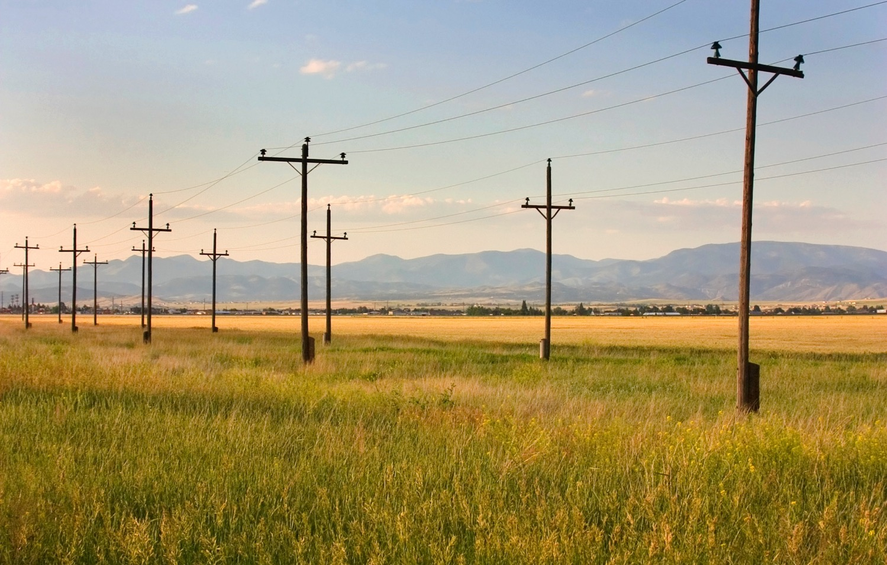
Questions

Slide 11

Comments / Suggestions
Kenna Hagan
Manager FERC Tariff Administration & Policy
Transmissionservice@blackhillscorp.com
(605) 721-2200
Jacki Welbig
Electric Transmission System Analyst
Jacki.Welbig@blackhillscorp.com
(605) 721-2310

